Slide 1
Introduction to Database Management Systems
Lecture 01
Week 01
DBS211

Slide 2
Agenda
Data vs. Information
File Systems
Database
Database Management System
Database Design

Slide 3
Data vs. Information
Data:
Unprocessed information
i.e. customer, course, employee
Building blocks of information
Information:
Information reveals the meaning of data
Produced by processing data which is related
i.e. credit card statement, phone bill, video rental
Accurate and timely information is need for decision making
Good decision making is key to an organization’s survival

Slide 4
Agenda
Data vs. Information
File Systems
Database
Database Management System
Database Design

Slide 5
File Systems
Programs were written to access data.
i.e. to get information about a customer, a program would be written to do just that (and nothing else).
Program would go against a specific file (or files, depending on it’s purpose)
If other information was needed, another program was written
Programmer had to specify exactly how the processing of the data needed to be done

Slide 6
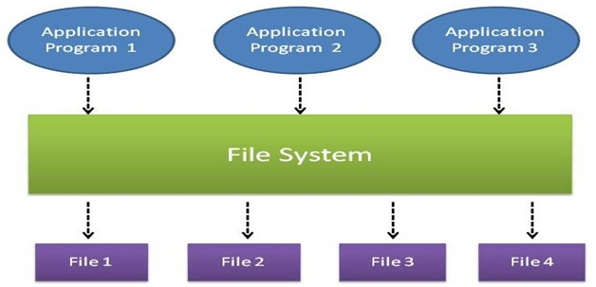
File Systems

Slide 7
File Systems (Example)
Simple business example:
A customer orders products from a Retailer
Sales Department would take the order information from the customer
Sales Department would send a request to the Shipping Department to deliver a product to a customer
The Shipping Department would enter in the information about the customer order and create a shipping document
The Shipping Department would print the shipping document and send the products to the Customer

Slide 8
File Systems (Cont’d)
Possible required files to store data:
Files required in Sales Department:
Customer, Product, Sale
Files required Shipping Department:
Customer, Shipping Document
Can anybody see a problem with this?
Where would you go to look up the phone number for a customer?

Slide 9
Data Redundancy
Same data appears in more than one location
Customer data exists in two different files:
Sales Department:
Customer, Product, Sale
Shipping Department:
Customer, Shipping Document
Results in data inconsistency
Data anomalies result when changes to redundant data are not made successfully.

Slide 10
File Systems
What if you wanted some information from a file quickly?
Could not be done using a traditional file system.
Why? Programs specified exact structure of a file. Think of the complexity if information was required from multiples files!

Slide 11
File Systems
What if you wanted to change the structure of a file?
All the programs that used that file would have to be changed.

Slide 12
Data Anomalies
Modification anomalies
Insertion anomalies
Deletion anomalies

Slide 13
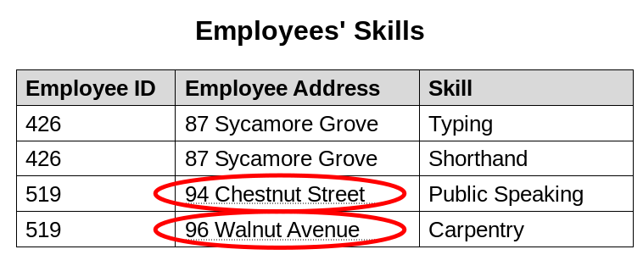
Modification Anomaly
Change the address for employee 519 – has to be done for all rows with employee ID 519.
What if this employee address is in another table (file) – has to be done for all tables (files)

Slide 14
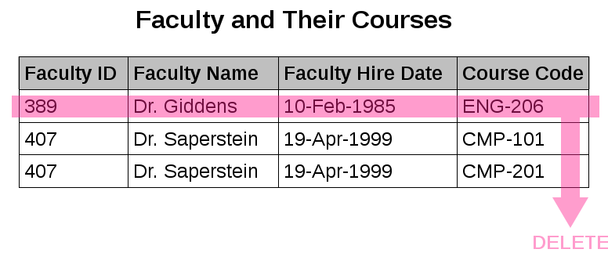
Deletion Anomaly
Dr. Giddens is not teaching ENG-206 this semester
We could lose the hire date if we remove this row to reflect current faculty and their courses

Slide 15
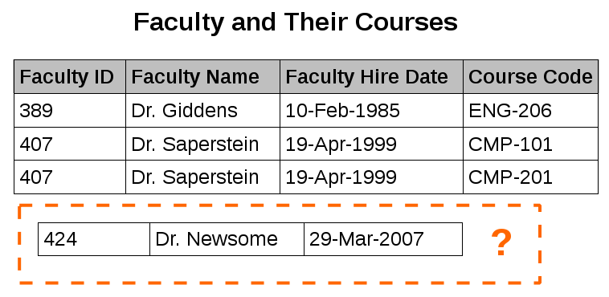
Insertion Anomaly
We can record the details of any faculty member who teaches at least one course in 2007
We cannot record the details of a newly hired faculty member who has not yet been assigned to teach any courses

Slide 16
Agenda
Data vs. Information
File Systems
Database
Database Management System
Database Design

Slide 17
Database
Database
A structure that contains logically related data in a single repository
A Database contains:
End user component – data
Metadata – data about data

Slide 18
Types of Databases
Centralized
Supports one or more users at a time
Database is in one physical location
Database could be on a pc, a mid-range, or a main-frame
Distributed:
Data is distributed at several physical locations
Database at each physical locations can vary (i.e. one location might have the database on a mid-range, one might have it on a pc)

Slide 19
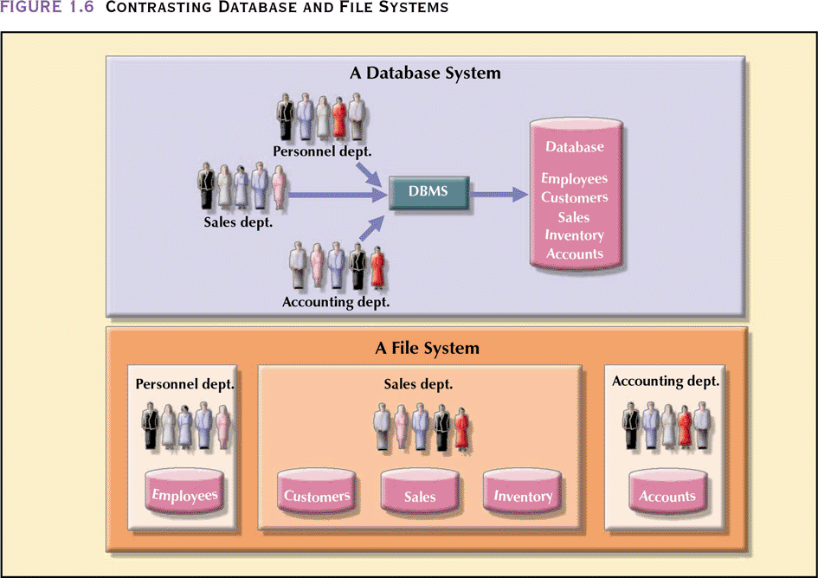
Database vs. File System

Slide 20
Database Uses
Production or Transaction
Supports day-to-day operations
Decision Support
Information for tactical or strategic decision making
Data Warehouse
Historical data

Slide 21
Advantages of Database Processing
Ability to get more information from the same amount of data
i.e. all customer related data is in one customer place
Sharing data
Data is available to be use by authorized users
Controlling Redundancy
Only a single copy of the data exists

Slide 22
More Advantages
Balancing
Databases are structured to benefit all users in the organization, not just a single group
Expanding security
Access to data can be password protected or can restrict access to data – read only, update

Slide 23
Advantages Continued
Increasing Productivity
Ability to write ad hoc queries
Users don’t have to know exact structure of the data
Provides data independence
Can change the structure of the data without having to change the programs that access it

Slide 24
Disadvantages of Database Processing
Large file size
Files now include metadata information
Increased complexity
Need to take into consideration data design, security, backup and recovery, integrity

Slide 25
More Disadvantages
Greater impact of failure
Data is now shared, if a failure occurs, many users are impacted
More difficult recovery
If data can be updated by many users at the same time, how can it be recovered to the correct state for all users correctly

Slide 26
Agenda
Data vs. Information
File Systems
Database
Database Management System
Database Design

Slide 27
Database Management System (DBMS)
Collection of programs that manages database structure and controls access to the database (and ultimately the data)
Manages sharing of data among multiple applications and users
Data is more consistent
Ability to do ad hoc querying

Slide 28
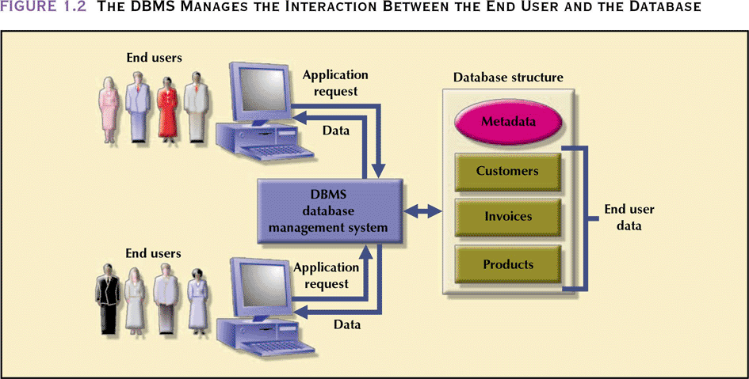
Database Management System (DBMS)

Slide 29
Importance of a DBMS
For Top Management
Provides information necessary for strategic decision making and planning
Provides access to external and internal data
Provides information on company performance and whether the company is achieving their goals (targets) or not
For Middle Management
Provides information necessary for tactical decision making planning

Slide 30
Importance of a DBMS
For Operational Management
Provides timely information
Represents and supports the company operations as closely as possible (operational data)
For Other Users
Provides timely information
Produces results within specified performance levels

Slide 31
Agenda
Data vs. Information
File Systems
Database
Database Management System
Database Design

Slide 32
Database Design
Defines the database’s expected use
Avoids redundant data (unnecessarily duplicated)
Eliminates poorly designed databases
Done within a systems development life cycle (SDLC) framework
Database Design has it’s own framework, within the SDLC called the Database Life Cycle (DBLC)

Slide 33
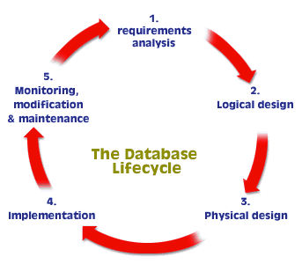
Database Development Life Cycle

Slide 34
Database Design
Different database design strategies exist: top-down, bottom-up, centralized and decentralized
The database topic will be covered in database design and modeling lecture.

